Slide 1
INFORMATION TECHNOLOGY
(Front-End Development)
Presented by: Rohit Singh

Slide 2
What is IT?
Information Technology, commonly referred to as IT, refers to the use of technology to organize, store, share, and process information. The IT industry is growing quickly as companies become more technology-based and the need to manage information becomes increasingly vital.

Slide 3
FRONT-END DEVELOPMENT
Front-end development is the process of creating the visual and interactive elements of a website that users interact with directly. It includes the user interface, buttons, user-entered data, websites, and user experience (UX) features.
Front-end development uses a combination of HTML, CSS, and JavaScript. HTML provides the structure, CSS provides the styling and layout, and JavaScript provides the dynamic behavior and interactivity.

Slide 4

What is React.js React JS is a popular javascript library used for building user interfaces. It was developed by facebook and has gained widespread adoption due to its ease of use and flexibility. React allows developers to create reusable UI components and manage complex UI interactions with ease.

Slide 5
Why I Choose This?
React is an open-source JavaScript library for building user interfaces. It is used by many companies, including Facebook, Netflix, and Airbnb.
Here are some of the reasons why i choose React.js:
Easy to learn
Flexible
Reusable
Fast
Well-supported
SEO-friendly
Great developer experience

Slide 6
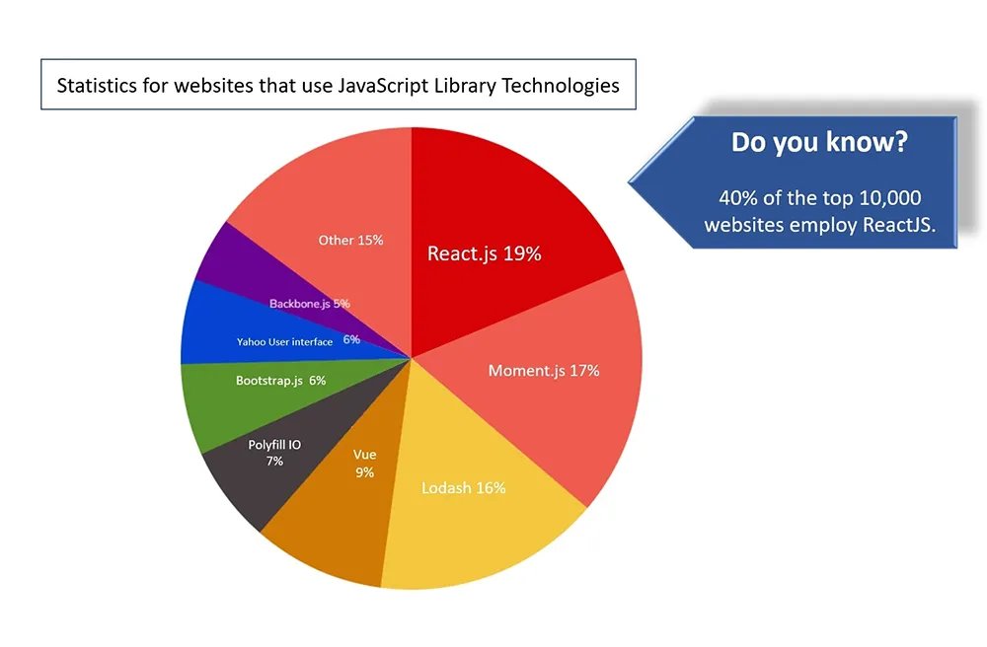

Slide 7




Most Popular Websites Built With React
Whatsapp
FACEBOOK
Spotify
Netflix

Slide 8
ADVANTAGES
Easy to learn: React is relatively easy to learn, even for developers who are new to JavaScript.
Reusable components: React components are self-contained units of code that can be reused throughout an application. This can save developers time and effort.
High performance: React's Virtual DOM can help to improve the performance of applications.
SEO friendly: React can be used to create SEO-friendly applications.
Large community: React has a large and active community that can provide support and resources to developers.

Slide 9
DisAdvantages
Poor Documentation.
It covers only UI hence we need to use other languages to make a full application.
The high pace of development makes developer life difficult.
JSX as a barrier

Slide 10
Thank you

